Slide 1
Lecture 12: First-Order Systems
Time Response
Lecture 12:
Introduction to time response analysis
First-order systems
Stability
Lecture 13: Second-order systems
Lecture 14: Non-canonical systems

Slide 2
Time Response
During the semester we have found the time response of dynamic systems for arbitrary initial conditions and inputs
From diff eq and transfer function models
Classifying the response of some standard systems to standard inputs can provide insight
Ex Systems: first order, second order
Ex Inputs: impulse, step, ramp, sinusoid
Notes:
Many systems can be approximated well by first or second order systems (even if they are actually higher order)
Examples
an impulse is a shock test, like a car suspension going over a bump
a step is like a driver just slamming on the accelerator or brake
a ramp is a steady acceleration
Sinusoids of different frequencies can be used to understand the response of a system to complicated inputs made of lots of frequencies

Slide 3
Time Response
Characteristics of a standard response can be used for specifications (transient and steady state)
Response to simple inputs can be used for system identification, i.e. for finding a black-box model
SYSTEM
Notes:
Mentioned earlier, empirical derivation of models

Slide 4
First-Order Systems
Basic form:
Key parameters:
τ = time constant
k = DC gain
Many real systems have this basic form
Notes:
Called first order because the differential equation has only a first derivative and the transfer function has a single pole

Slide 5
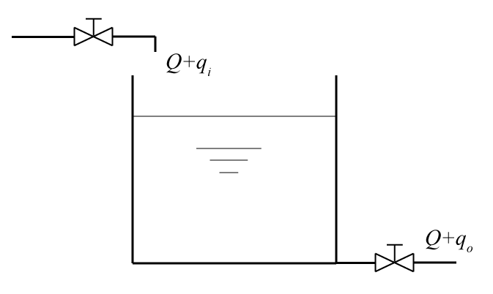
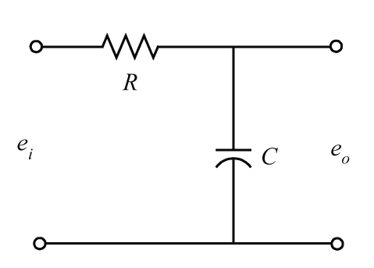
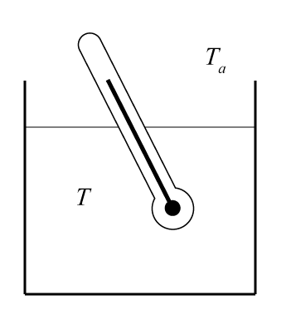
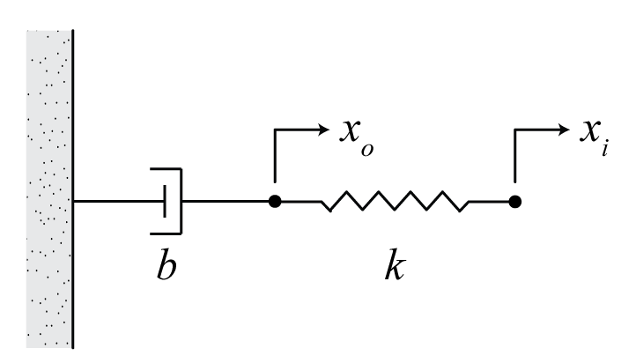
Notes:
Page 389 from Ogata … try to tie to automotive applications

Slide 6
First-Order Systems
Step response (u(t) = 1(t))
Notes:
Point out homogenous and particular solution, relation to poles

Slide 7
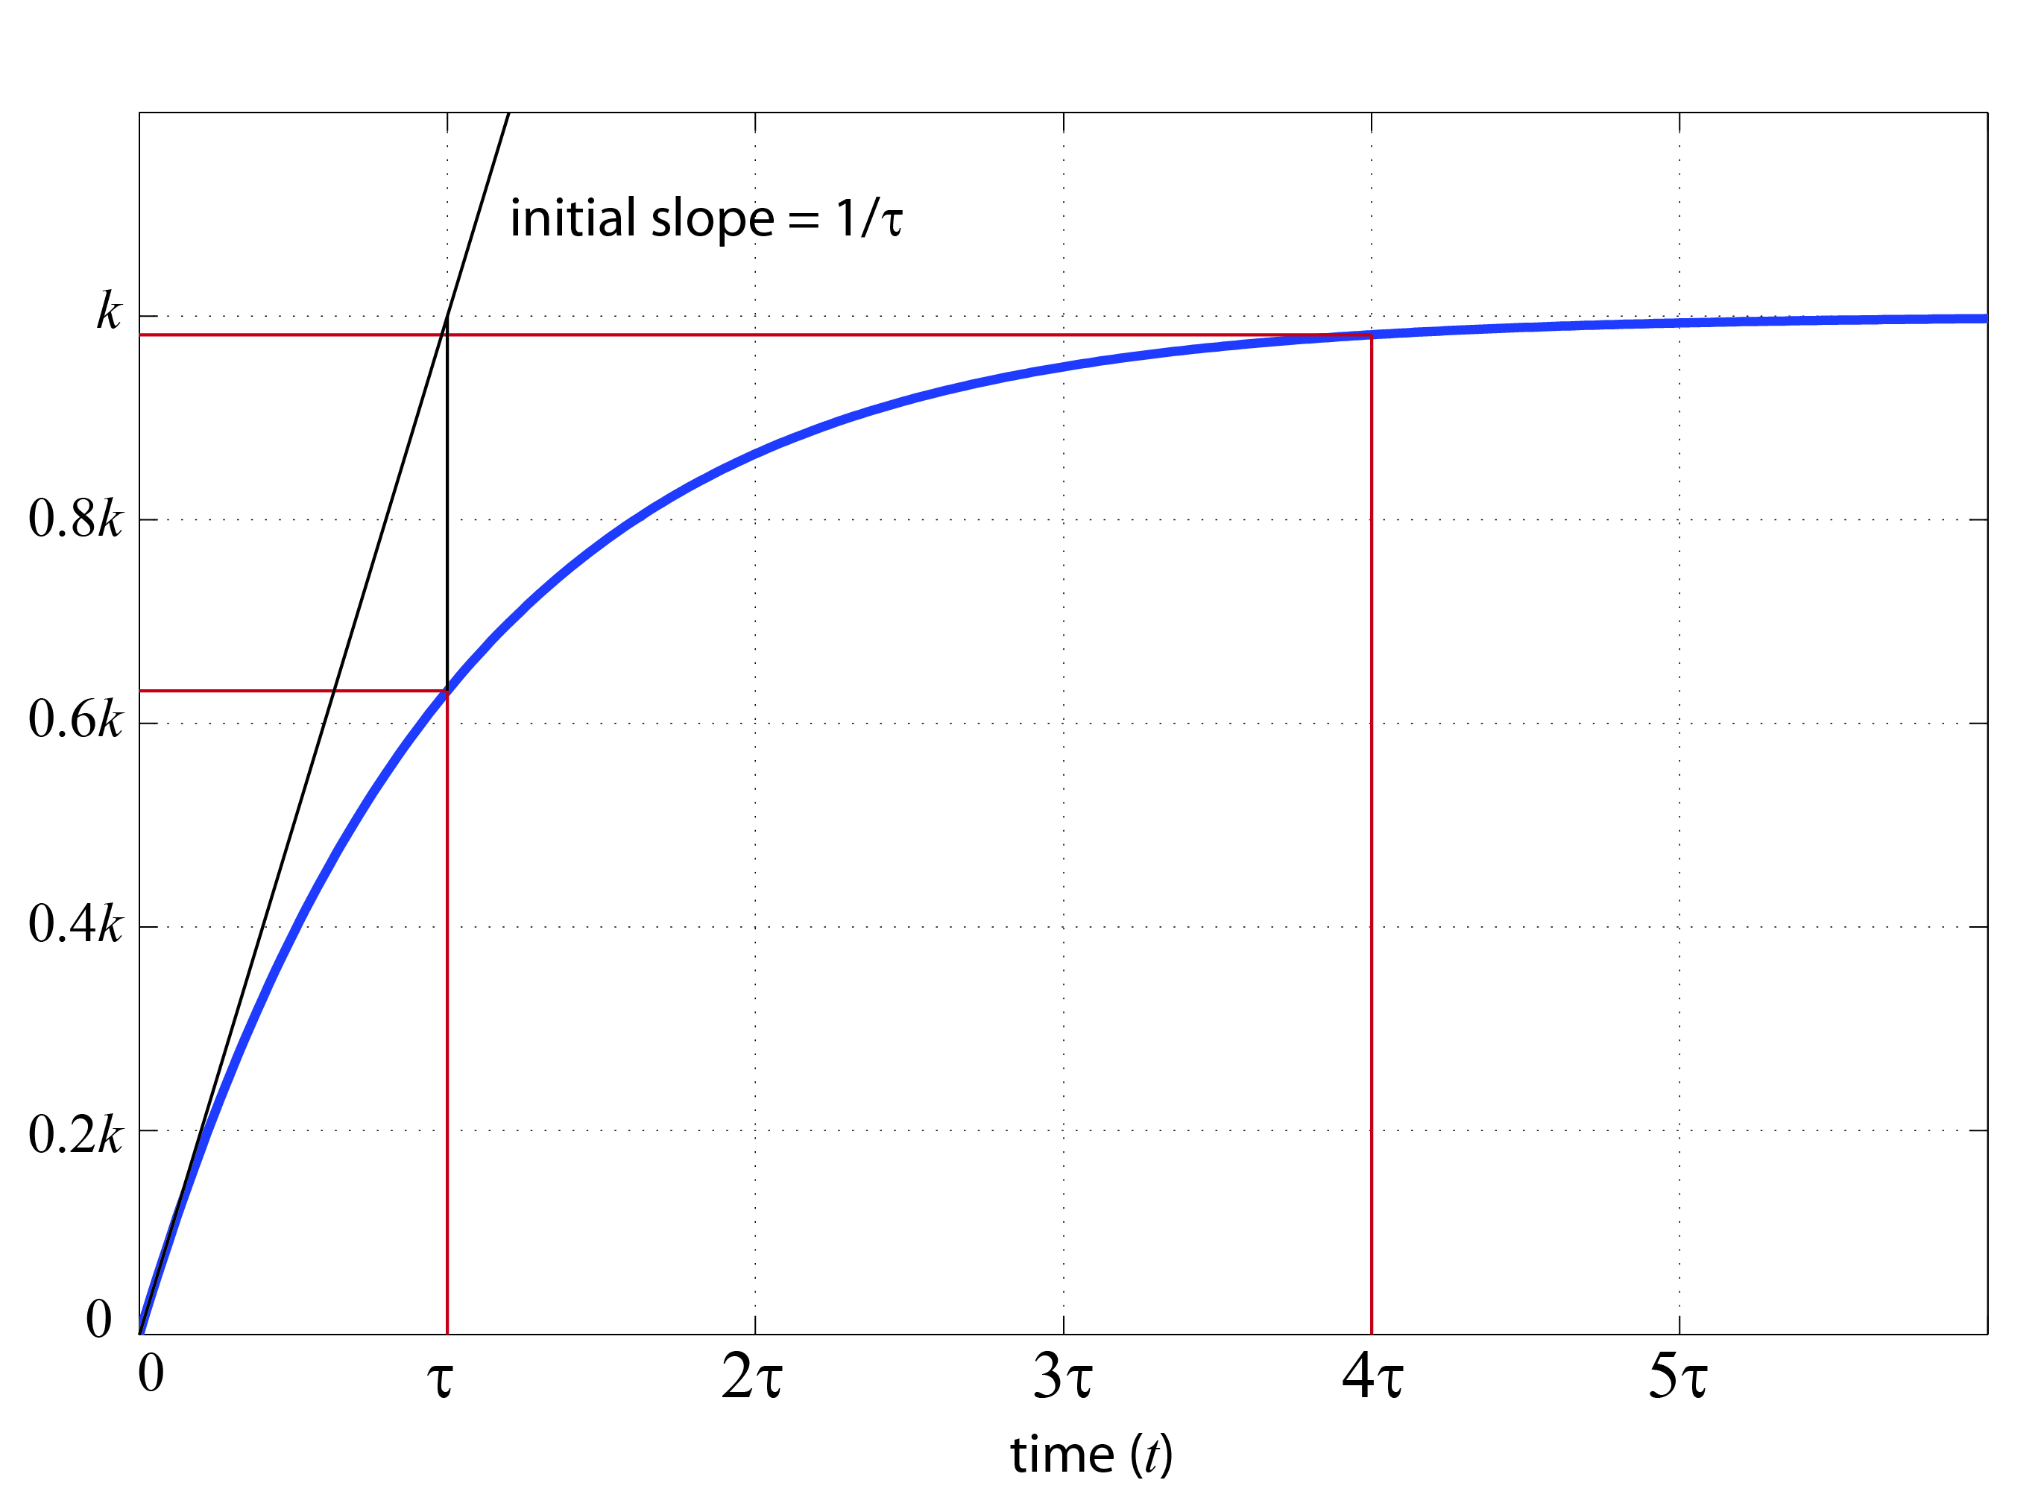
First-Order Systems
steady
state
transient
For t=τ
For t=4τ
within 2% of final value is
generally considered ss
Notes:
initial value, t=0
Final value, t approaches infinity, can see why k is called steady state gain, DC gain … could also find using the initial value theorem or final value theorem
Steady state tends to be related to the forcing input

Slide 8
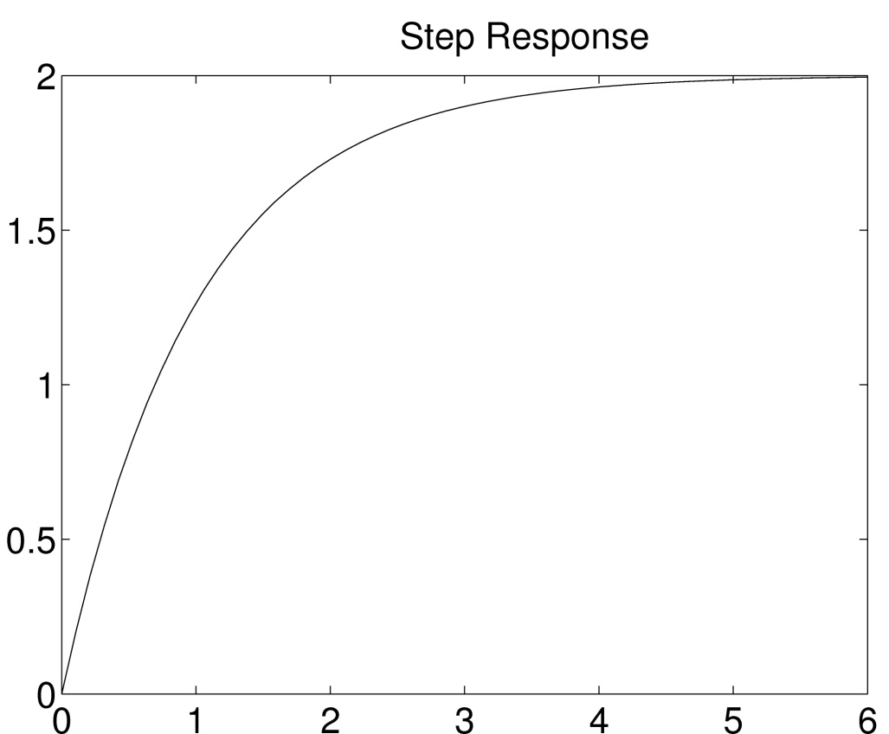
Example
Determine the TF of the system that produced the following output in response to a unit step input

Slide 9
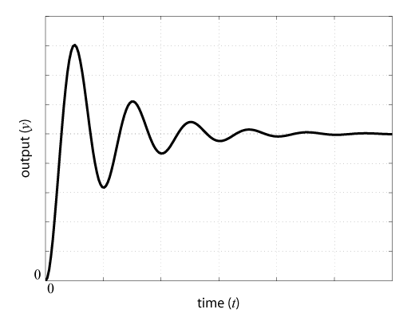
Second-Order Systems
Step response of 2nd-order system with complex poles

Slide 10
Stability
Note how the roots of the characteristic equation (poles of the transfer function) relate to natural response
Real part of pole = rate of decay (growth)
Imag part of pole = frequency of oscillation
If the response does not grow unbounded then it is stable (real part less than or equal to 0)
Notes:
What do we need to be true for a system’s response to be stable? If less than zero, if equal to zero

Slide 11
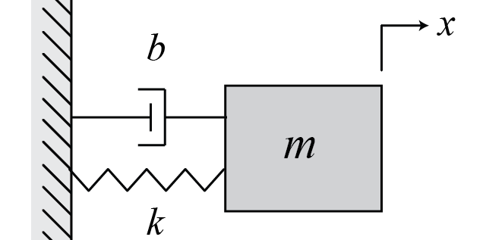
Stability
Asymptotic Stability: for no input and any initial condition, output x → 0 as t → ∞
example:
condition: all roots of the characteristic equation have negative real parts
if b = 0? stable, but not asymptotically stable!
Notes:
Car suspension example, driveline example … resonance!

Slide 12
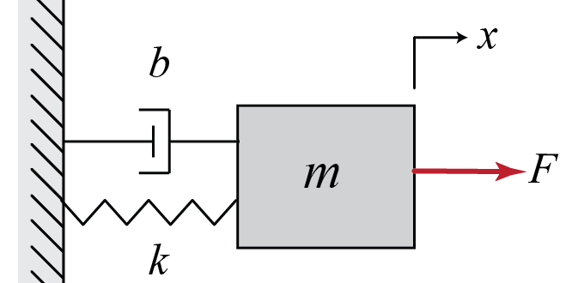
Stability
BIBO Stability: for zero initial conditions and bounded input, output x is bounded for all t
example:
condition: all poles of transfer function (roots of characteristic equation) have negative real part
if b = 0? stable, but not BIBO stable!
Notes:
Same requirement for linear systems

